Slide 1
Big Mountain Resort
A Data Driven Approach to Ticket Pricing

Slide 2
Problem Identification:
Big Mountain Resort has increased operating costs after installing a new chair lift.
In addition, there is some concern over the current ticket price.
In order to meet the new costs, management has asked us to perform a data driven analysis on ticket price and a number of other features to find a way to recoup these costs.

Slide 3
Recommendation and Key Findings
Our model suggests that a ticket price of $95.97 could be supported by Big Mountain's facilities.
An increase in ticket price of $1.45 per ticket would result in an annual increase of $2545455.00, which more than covers the new operating costs.
In addition, we recommend closing some of the runs during non-peak portions of the year to reduce operating costs further. The business could start with closing one run and reevaluate. The model suggests that you may close up to six runs without a decrease in ticket sales.

Slide 4
Modeling Results:
Big mountain resort is a destination resort and should compete against other destination resorts.
Our research shows that the most important features with respect to ticket price are vertical drop, snow making acres, total ski lifts, number of fast quad lifts, number of runs, longest run, and skiable terrain.
Big mountain resort is near the top or at least competitive in all of these categories which supports the increased ticket price.

Slide 5
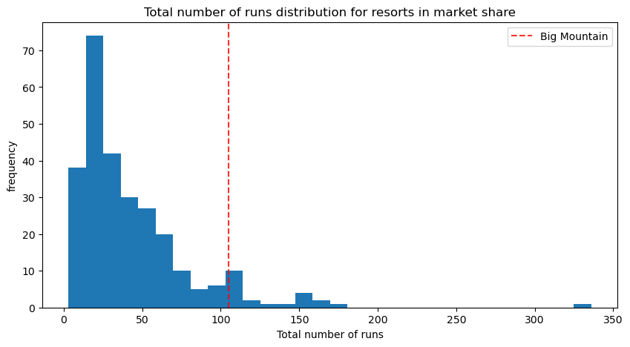
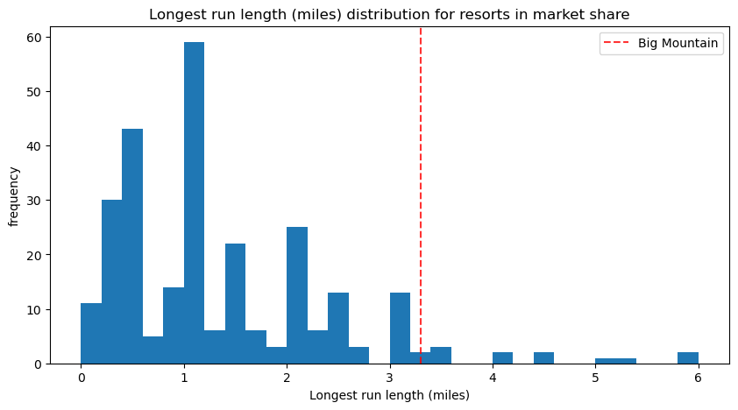
Modeling Results:
Here BMR is near the top in total number of runs.
BMR is again close to the longest run length in miles.

Slide 6
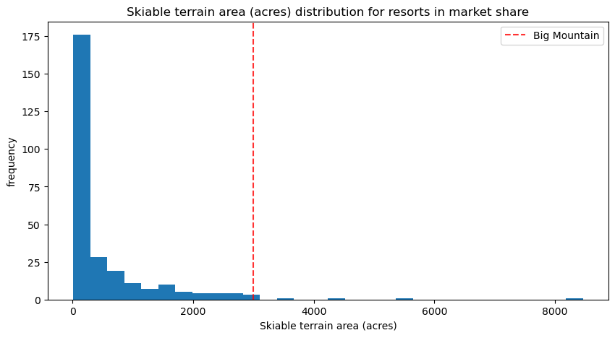
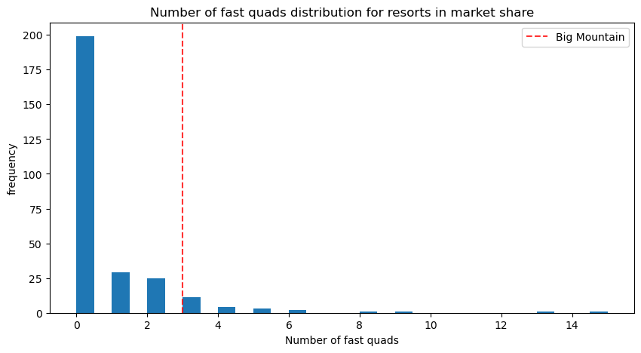
Modeling Results:
BMR at the top for skiable terrain.
BMR is near the top again for number of fast quads.

Slide 7
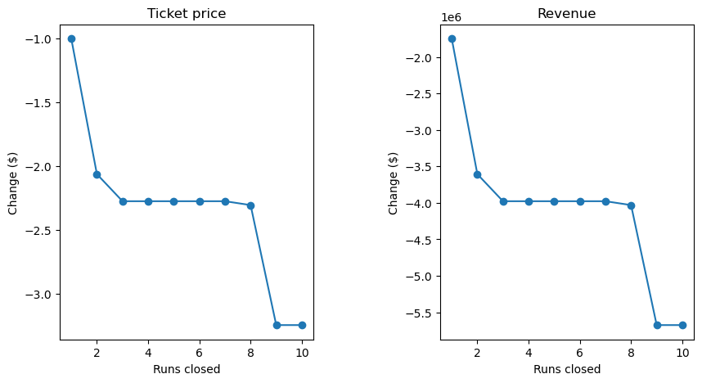
Modeling Results:
We show here the relationship between shutting runs down and ticket price which suggests, if closing just 2 runs, one might as well close 8, since it does not significantly change revenue.

Slide 8
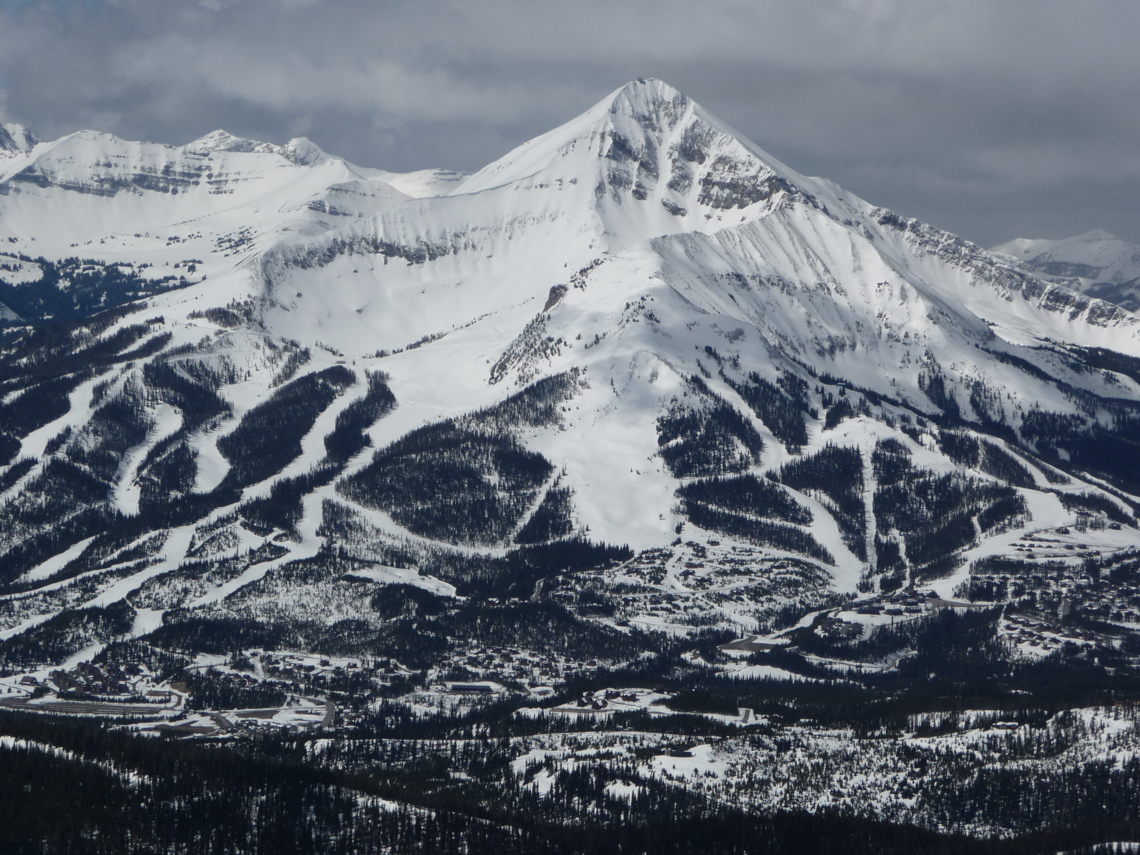
Conclusion
The modeled price was higher than the current price because the model took into account data from across the country. Big Mountain is a destination ski resort and should be competing at this level. According to the data, an increase in ticket price is warranted.

